Slide 1

PROJECT TITLE –
HEALTHCARE ANALYTICS FOR DOCTOR VISITS
NAME : UJJWAL GUPTA
AICTE STU ID : STU68374882bc9891748453506

Slide 2

PROBLEM STATEMENT
Staffing Issues: Hospitals struggle to predict how many patients will visit, causing long waiting lines and staff stress.
Different Patient Needs: People of different ages, genders, and incomes use healthcare in completely different ways.
Insurance Gaps: It is unclear how government medical aid for low-income and older patients affects clinic visits compared to private insurance.

Slide 3
PROJECT DESCRIPTION
.
Smart Data Ingestion: Analyzed a clean, real-world database of 5,190 patient records with no missing information.
Tracking Key Factors: Studied how things like gender, income, and how sick a patient feels change how often they visit the doctor.
Better Health Logistics: Uses data patterns to help hospital managers know exactly when they need more doctors or medicine on hand.

Slide 4

WHO ARE THE END USERS?
Hospital Managers: They use the data to schedule the right number of doctors and stop long checkout queues.
Health Policy Makers: They can check if government free medical benefits are helping low-income and older citizens effectively.
Medical Researchers: They study how an individual's background and temporary illnesses affect actual clinical visits.
Medicine Suppliers: They use these patterns to send vaccines and medicines to the clinics that need them most.

Slide 5

TECHNOLOGY USED
Python: The core programming language used to load and calculate all statistical metrics.
Pandas: Used to clean the dataset, handle empty fields, and sort rows and columns.
NumPy: Used to perform fast mathematical calculations and process data arrays efficiently.
Matplotlib & Seaborn: Used to build simple graphs, chart layouts, and color-coded comparison tables.
Google Colab: The online notebook environment where all the data code was written and run.

Slide 6
RESULTS
Top Driver: Immediate sickness and restricted activity days are the main reasons people visit the doctor.
Income Factor: Lower-income individuals visit doctors much more frequently than higher-income groups.
Activity Impact: Patients with 14 days of restricted activity go to the doctor 10 times more often than those with 0 days.
Demographics: The data skews slightly female (52%), with high reliance on public health aid programs.
Github Link

Slide 7
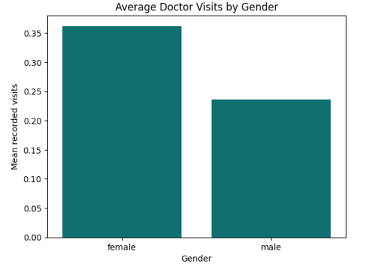
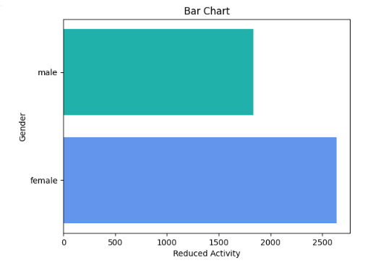
RESULTS
Github Link

Slide 8
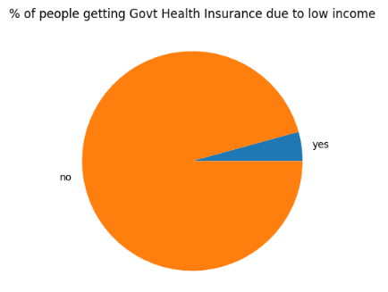
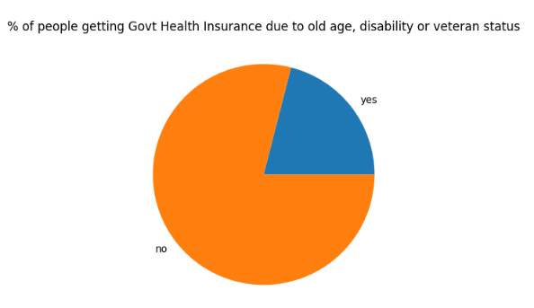
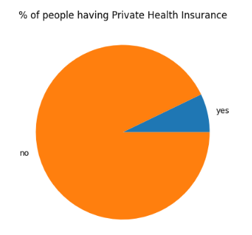
RESULTS
Github Link

Slide 9
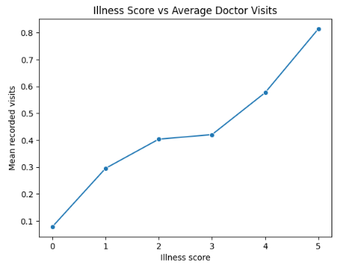
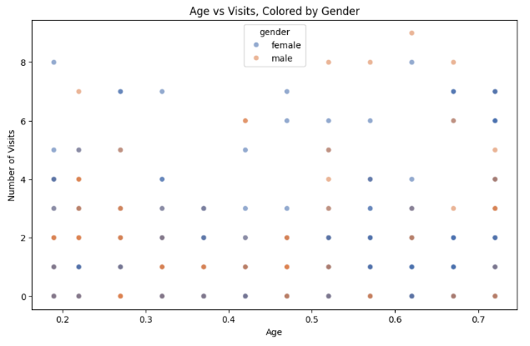
RESULTS
Github Link

Slide 10
THANK YOU
.
.

